Slide 1
Computer Organization and Architecture
Module 4
Design of Control Unit
Department of Computer Science and Engineering
IIT Kharagpur

Slide 2
Design of Control Unit

Slide 3
Instructions
Instructions are stored in main memory.
Program Counter (PC) points to the next instruction.
  MIPS32 instructions are 4 bytes (32 bits) long.
  All instructions starts from an address that is multiple of 4 (last 2 bits 00).
  Normally, PC is incremented by 4 to point to the next instruction.
  For branch, PC is loaded with the address of the target instruction.
12
8
4
instruction word
0
instruction word

Slide 4
Addressing a Byte in Memory
Each byte in memory has a unique address.
  Memory is said to be byte addressable.
Typically the instructions are of 4 bytes, hence the instruction memory is addressed in terms of 4 bytes (word length = 32 bits).
When an instruction is executed, PC is incremented by 4 to point to the next instruction.
  In MIPS32, words are byte aligned.
  Every word (including instruction) starts from a memory address that is some multiple of 4 (i.e., last two bits are `00’).

Slide 5
How an instruction Gets Executed?
Main Memory
repeat forever
// till power off or
// system failure
{
  Fetch instruction
  Decode instruction
  Execute instruction
  }
Fetch
Decode
Execute

Slide 6
The Fetch-Execute Cycle
Fetch the next instruction from memory.
Decode the instruction.
Execute the operation.
  Get data from memory if needed (data not available in the processor).
  Perform the required operation on the data.
  May also store the result back in memory or register.

Slide 7
Registers: PC and IR
Program Counter (PC) holds the address of the memory location containing the next instruction to be executed.
Instruction Register (IR) contains the current instruction being executed.
Basic processing cycle:
  Instruction Fetch (IF)
    IR ← Mem [PC]
  Considering the word length of the machine is 32 bits, the PC is incremented by 4 to point to the next instruction.
    PC ← PC + 4
  Carry out the operations specified in IR.

Slide 8
Example: Add R1, R2
PC = 1000
MAR = 1000
PC = PC + 4 = 1004
MDR = “ADD R1, R2”
IR = “ADD R1, R2”
(Decode and finally execute)
R1 = R1 + R2
Address | Instruction
1000 | ADD R1, R2
1004 | MUL R3, R4
May require one or more steps depending on the target architecture.

Slide 9
Requirement for Instruction Execution
The necessary registers must be present.
The internal organization of the registers must be known.
The data path must be known.
For instruction execution, a number of micro-operations are carried out on the data path.
  An instruction consists of several micro-operations or micro-instructions.
  Typically involves movement of data.

Slide 10
Kinds of Data Movement
Broadly three types:
  Register to Register
  Register to ALU
  ALU to Register
Data movement is supported in the data path by:
  The Registers
  The Bus (single or multiple)
  The ALU temporary Register (Y and Z)

Slide 11
Single Bus Organization
Internal Processor Bus
PC
Instruction Decoding and Control Unit
Control signals
.
.
.
MEMORY
MAR
MDR
IR
4
Y
R0
Select
MUX
R1
General-purpose Registers
.
.
.
Function select
ALU
Carry-in
R_{n-1}
Z

Slide 12
Single Internal Bus Organization
All the registers and various units are connected using a single internal bus.
Registers R₀-R_{n-1} are general-purpose registers used for various purposes.
Registers Y and Z are used for storing intermediate results and never used by instructions explicitly.
The multiplexer selects either a constant 4 or output of register Y.
  When PC is incremented, a constant 4 has to be added.

Slide 13
The instruction decoder and control unit is responsible for performing the actions specified by the instruction loaded into IR.
The decoder generates all the control signals in the proper sequence required to execute the instruction specified by the IR.
The registers, the ALU and the interconnecting bus are collectively referred to as the data path.
The control unit that generates the control signals in proper sequence is referred to as the control path.

Slide 14
Kinds of Operations
Transfer of data from one register to another.
  MOVE R1, R2 // R1 = R2
Perform arithmetic or logic operation on data loaded into registers.
  ADD R1, R2 // R1 = R1 + R2
Fetch the content of a memory location and load it into a register.
  LOAD R1, LOCA // R1 = Mem[LOCA]
Store a word of data from a register into a given memory location.
  STOR LOCA, R1 // Mem[LOCA] = R1

Slide 15
Three Bus Organization
A typical 3-bus architecture for the processor datapath is shown in the next slide.
  The 3-bus organization is internal to the CPU.
  Three buses allow three parallel data transfer operations to be carried out.
Less number of cycles required to execute an instruction compared to single bus organization.

Slide 16
Bus A
Bus B
Bus C
Incrementer
PC
We assume that two register reads and one register write operations can be carried out in a single clock cycle.
Register File
4
M
U
X
A
L
U
Instruction Decoder
IR
Memory
Data
MDR
Address
MAR

Slide 17
Organization of a Register
A register is used for temporary storage of data (parallel-in, parallel-out, etc.).
A register Ri typically has two control signals.
  Ri_{in} : used to load the register with data from the bus.
  Ri_{out} : used to place the data stored in the register on the bus.
Input and output lines of the register Ri are connected to the bus via controlled switches.
  If Ri_{out} is not selected, the register outputs are set in the high impedance state.
Ri_{in}
Register Ri
Ri_{out}

Slide 18
Ri_{in}
When (Ri_{in} = 1), the data available on bus is loaded into Ri.
Register Ri
Ri_{out}
Ri_{in}
When (Ri_{out} = 1), the data from register Ri are placed on the bus.
Register Ri
Ri_{out}

Slide 19
Register Transfer
R1_{in}
MOVE R1, R2 // R1 ← R2
  Enable the output of R2 by setting R2_{out} = 1.
  Enable the input of register R1 by setting R1_{in} = 1.
  All operations are performed in synchronism with the processor clock.
    The control signals are asserted at the start of the clock cycle.
    After data transfer the control signals will return to 0.
  We write as T1: R2_{out} , R1_{in}
Register R1
R1_{out}
R2_{in}
Register R2
R2_{out}
Time Step
Control Signals

Slide 20
ALU Operation
Ri_{in}
X
Ri
ADD R1, R2 // R1 = R1 + R2
  Bring the two operands (R1 and R2) to the two inputs of the ALU.
    One through Y (R1) and another (R2) directly from internal bus.
  Result is stored in Z and finally transferred to R1.
  T1: R1_{out} , Y_{in}
  T2: R2_{out} , SelectY, ADD, Z_{in}
  T3: Z_{out} , R1_{in}
Ri_{out}
X
Y_{in}
X
Y
4
S
MUX
ALU
Z_{in}
X
Z
X
Z_{out}

Slide 21
Fetching a Word from Memory
The steps involved to fetch a word from memory:
  The processor specifies the address of the memory location where the data or instruction is stored (move to MAR).
  The processor requests a read operation.
    The information to be fetched can either be an instruction or an operand of the instruction.
  The data read is brought from the memory to MDR.
  Then it is transferred to the required register or ALU for further operation.

Slide 22
Storing a Word into Memory
The steps involved to store a word into the memory:
  The processor specifies the address of the memory location where the data is to be written (move to MAR).
  The data to be written in loaded into MDR.
  The processor requests a write operation.
  The content of MDR will be written to the specified memory location.

Slide 23
Connecting MDR to Memory Bus and Internal Bus
Memory bus
MDR_{inE}
MDR_{in}
Memory Function Complete
Memory
Internal processor bus
MFC
MDR
MAR
MDR_{outE}
MDR_{out}

Slide 24
Memory read/write operation:
  The address of memory location is transferred to MAR.
  At the same time a read/write control signal is provided to indicate the operation.
  For read, the data from memory data bus comes to MDR by activating MDR_{inE} .
  For write, the data from MDR goes to memory data bus by activating the signal MDR_{outE} .
  When the processor sends a read request, it has to wait until the data is read from the memory and written into MDR.
  To accommodate the variability in response time, the process has to wait until it receives an indication from the memory that the read operation has been completed.
  A control signal called Memory Function Complete (MFC) is used for this purpose.
    When this signal is 1, indicates that the contents of the specified location is read and are available on the data line of the memory bus.
    Then the data can be made available to MDR.

Slide 25
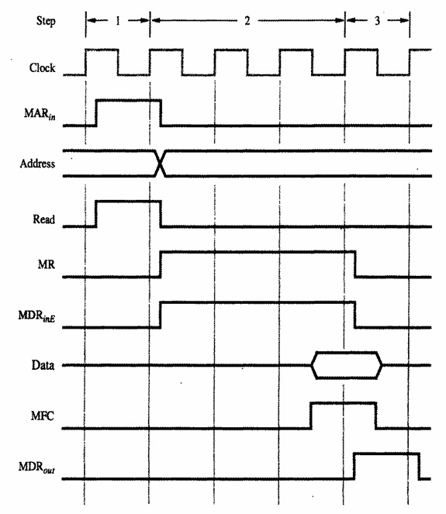
Timing Diagram for Read Operation
MAR ← R2
Start a Read operation on the memory bus
Wait for the MFC response from the memory
Load MDR from the memory
R1 ← MDR
Control steps:
  1. R2_{out} , MAR_{in} , Read
  2. MDR_{inE} , WMFC
  3. MDR_{out} , R1_{in}
Computer Organization, Fifth Edition, Carl Hamacher, Zvonko Vranesic, Safwat Zaky.

Slide 26
Fetch a word: MOVE R1, (R2)
MAR ← R2
Start a Read operation on the memory bus
Wait for the MFC response from the memory
Load MDR from the memory
R1 ← MDR
Control steps:
  R2_{out} , MAR_{in} , Read
  MDR_{inE} , WMFC
  MDR_{out} , R1_{in}

Slide 27
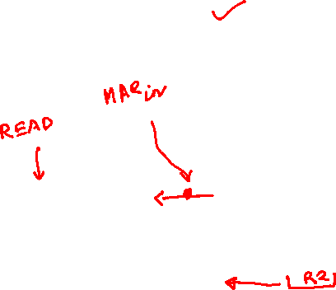
Fetch a word: MOVE R1, (R2)
MAR ← R2
Start a Read operation on the memory bus
Wait for the MFC response from the memory
Load MDR from the memory
R1 ← MDR
Control steps:
  R2_{out} , MAR_{in} , Read
  MDR_{inE} , WMFC
  MDR_{out} , R1_{in}

Slide 28
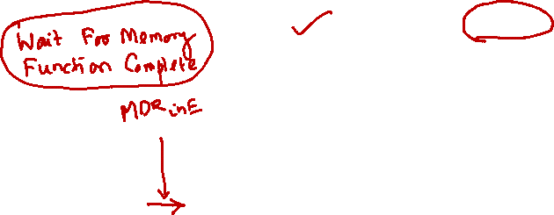


Fetch a word: MOVE R1, (R2)
MAR ← R2
Start a Read operation on the memory bus
Wait for the MFC response from the memory
Load MDR from the memory
R1 ← MDR
Control steps:
  R2_{out} , MAR_{in} , Read
  MDR_{inE} , WMFC
  MDR_{out} , R1_{in}

Slide 29
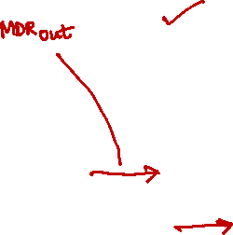
Fetch a word: MOVE R1, (R2)
MAR ← R2
Start a Read operation on the memory bus
Wait for the MFC response from the memory
Load MDR from the memory
R1 ← MDR
Control steps:
  R2_{out} , MAR_{in} , Read
  MDR_{inE} , WMFC
  MDR_{out} , R1_{in}

Slide 30
Store a word: MOVE (R1), R2
MAR ← R1
MDR ← R2
Start a Write operation on the memory bus
Wait for the MFC response from the memory
Control steps:
  R1_{out} , MAR_{in}
  R2_{out}, MDR_{in} , Write
  MDR_{outE} , WMFC

Slide 31
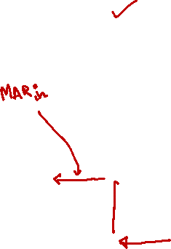
Store a word: MOVE (R1), R2
MAR ← R1
MDR ← R2
Start a Write operation on the memory bus
Wait for the MFC response from the memory
Control steps:
  R1_{out} , MAR_{in}
  R2_{out}, MDR_{in} , Write
  MDR_{outE} , WMFC

Slide 32
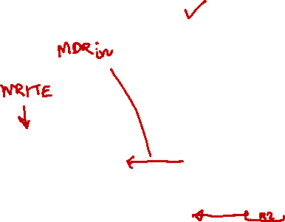
Store a word: MOVE (R1), R2
MAR ← R1
MDR ← R2
Start a Write operation on the memory bus
Wait for the MFC response from the memory
Control steps:
  R1_{out} , MAR_{in}
  R2_{out}, MDR_{in} , Write
  MDR_{outE} , WMFC

Slide 33
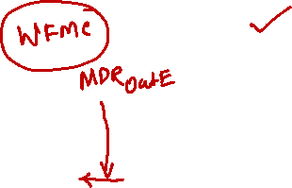
Store a word: MOVE (R1), R2
MAR ← R1
MDR ← R2
Start a Write operation on the memory bus
Wait for the MFC response from the memory
Control steps:
  R1_{out} , MAR_{in}
  R2_{out}, MDR_{in} , Write
  MDR_{outE} , WMFC

Slide 34
Execution of a Complete Instruction
Ri_{in}
ADD R1, R2 // R1 = R1 + R2
T1: PC_{out}, MAR_{in}, Read, Select4, ADD, Z_{in}
T2: Z_{out}, PC_{in}, Y_{in}, MDR_{inE} ,WMFC
T3: MDR_{out}, IR_{in}
T4: R1_{out}, Y_{in}, SelectY
T5: R2_{out}, ADD, Z_{in}
T6: Z_{out}, R1_{in}
X
Ri
Ri_{out}
X
Y_{in}
X
4
Y
S
MUX
ALU
Z_{in}
X
Z
X
Z_{out}

Slide 35
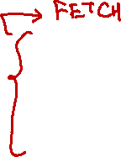
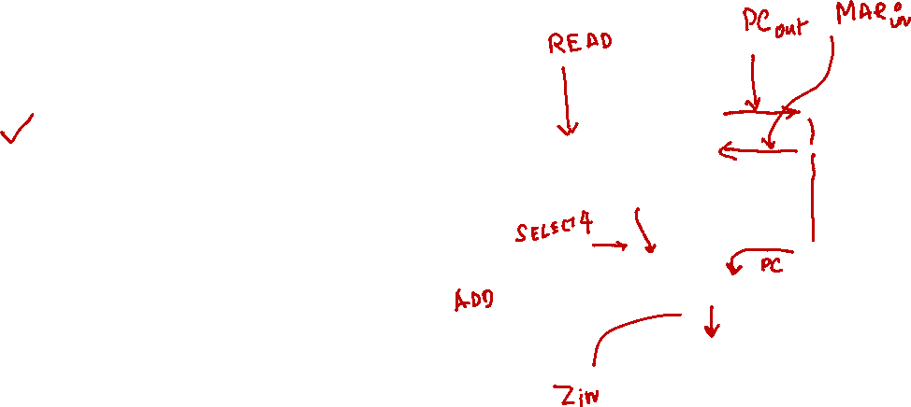
Execution of a Complete Instruction
ADD R1, R2 // R1 = R1 + R2
T1: PC_{out}, MAR_{in}, Read, Select4, ADD, Z_{in}
T2: Z_{out}, PC_{in}, Y_{in}, MDR_{inE} ,WMFC
T3: MDR_{out}, IR_{in}
T4: R1_{out}, Y_{in}, SelectY
T5: R2_{out}, ADD, Z_{in}
T6: Z_{out}, R1_{in}

Slide 36
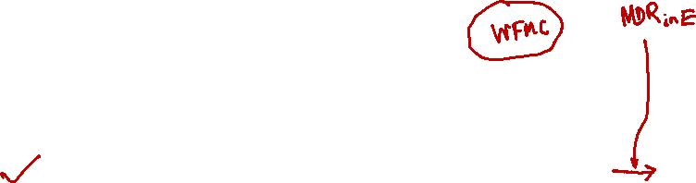
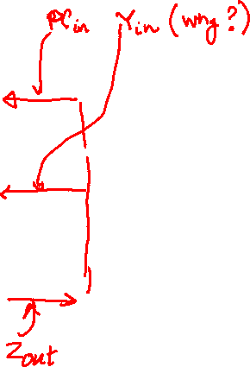
Execution of a Complete Instruction
ADD R1, R2 // R1 = R1 + R2
T1: PC_{out}, MAR_{in}, Read, Select4, ADD, Z_{in}
T2: Z_{out}, PC_{in}, Y_{in}, MDR_{inE} ,WMFC
T3: MDR_{out}, IR_{in}
T4: R1_{out}, Y_{in}, SelectY
T5: R2_{out}, ADD, Z_{in}
T6: Z_{out}, R1_{in}

Slide 37
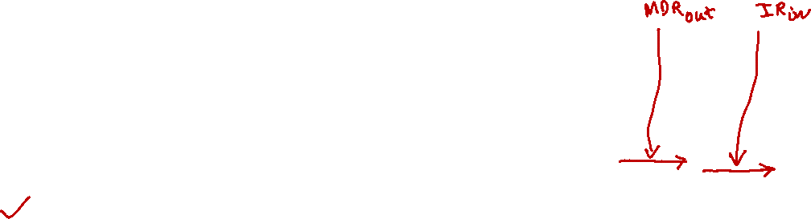
Execution of a Complete Instruction
ADD R1, R2 // R1 = R1 + R2
T1: PC_{out}, MAR_{in}, Read, Select4, ADD, Z_{in}
T2: Z_{out}, PC_{in}, Y_{in}, MDR_{inE} ,WMFC
T3: MDR_{out}, IR_{in}
T4: R1_{out}, Y_{in}, SelectY
T5: R2_{out}, ADD, Z_{in}
T6: Z_{out}, R1_{in}

Slide 38
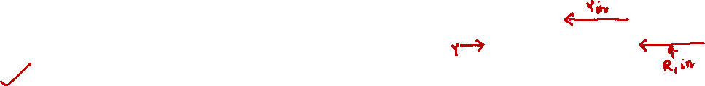
Execution of a Complete Instruction
ADD R1, R2 // R1 = R1 + R2
T1: PC_{out}, MAR_{in}, Read, Select4, ADD, Z_{in}
T2: Z_{out}, PC_{in}, Y_{in}, MDR_{inE} ,WMFC
T3: MDR_{out}, IR_{in}
T4: R1_{out}, Y_{in}, SelectY
T5: R2_{out}, ADD, Z_{in}
T6: Z_{out}, R1_{in}

Slide 39
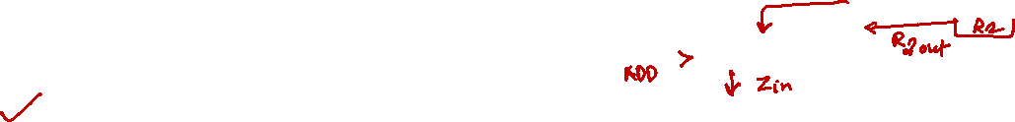
Execution of a Complete Instruction
ADD R1, R2 // R1 = R1 + R2
T1: PC_{out}, MAR_{in}, Read, Select4, ADD, Z_{in}
T2: Z_{out}, PC_{in}, Y_{in}, MDR_{inE} ,WMFC
T3: MDR_{out}, IR_{in}
T4: R1_{out}, Y_{in}, SelectY
T5: R2_{out}, ADD, Z_{in}
T6: Z_{out}, R1_{in}

Slide 40
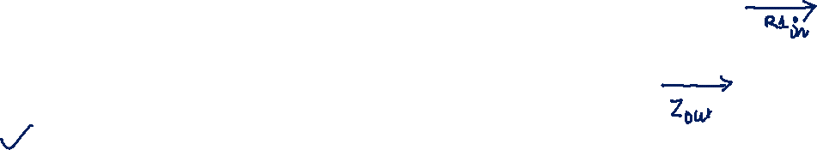
Execution of a Complete Instruction
ADD R1, R2 // R1 = R1 + R2
T1: PC_{out}, MAR_{in}, Read, Select4, ADD, Z_{in}
T2: Z_{out}, PC_{in}, Y_{in}, MDR_{inE} ,WMFC
T3: MDR_{out}, IR_{in}
T4: R1_{out}, Y_{in}, SelectY
T5: R2_{out}, ADD, Z_{in}
T6: Z_{out}, R1_{in}
SelectY can be placed in T4 or T5 since mux is a combinatorial circuit and its output will be generated almost instantly.

Slide 41



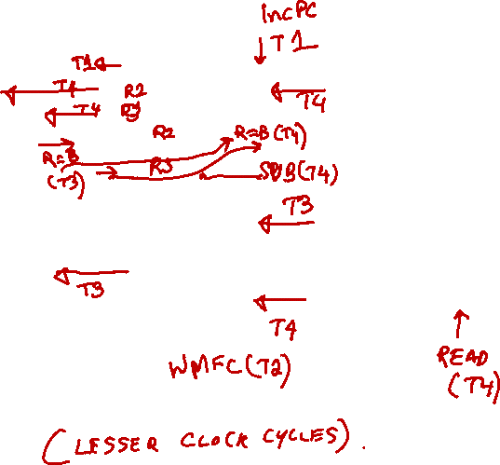

Example for a Three Bus Organization
SUB R1, R2, R3 // R1 = R2 – R3
T1: PC_{out}, R = B, MAR_{in} , READ, IncPC
T2: WMFC
T3: MDR_{outB} , R = B, IR_{in}
T4: R2_{outA} , R3_{outB} , SelectA, SUB, R1_{in} , End
R = B means that the ALU function is selected such that data on Bus-B is transferred to the ALU output (i.e., Bus-C).

Slide 42
Micro-operations Examples

Slide 43
Introduction
We select a set of 12 instructions.
Discuss the control signals required to execute these instructions on the single-bus processor architecture.

Slide 44
The set of 12 instructions chosen
ADD R1, R2 // R1 = R1 + R2
ADD R1, LOCA // R1 = R1 + Mem[LOCA]
LOAD R1, LOCA // R1 = Mem[LOCA]
STORE LOCA, R1 // Mem[LOCA] = R1
MOVE R1, R2 // R1 = R2
MOVE R1, #10 // R1 = 10
BR LOCA // PC = LOCA
BZ LOCA // PC = LOCA if Zero flag is set
INC R1 // R1 = R1 + 4
DEC R1 // R1 = R1 – 4
CMP R1, R2 // R1 – R2
HALT // Machine Halt

Slide 45
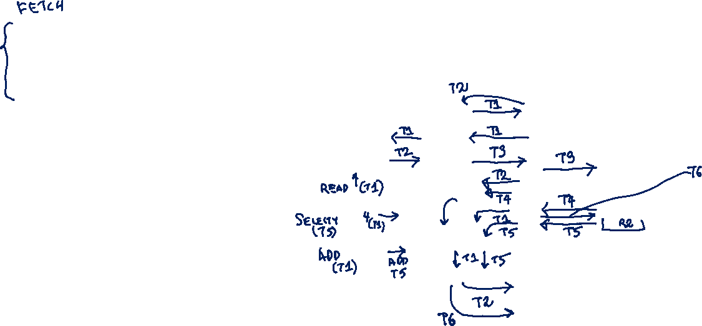
1. ADD R1, R2 (R1 = R1 + R2)
T1: PC_{out}, MAR_{in}, Read, Select4, Add, Z_{in}
T2: Z_{out}, PC_{in}, Y_{in}, MDR_{inE} ,WMFC
T3: MDR_{out}, IR_{in}
T4: R1_{out}, Y_{in}
T5: R2_{out}, SelectY, Add, Z_{in}
T6: Z_{out}, R1_{in}, End

Slide 46
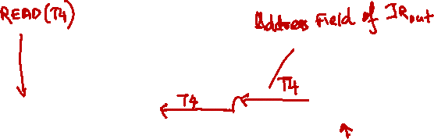
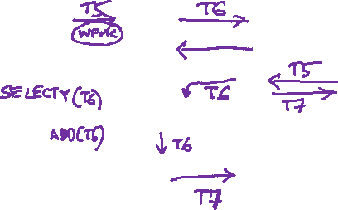
2. ADD R1, LOCA (R1 = R1 + Mem[LOCA])
T1: PC_{out}, MAR_{in}, Read, Select4, Add, Z_{in}
T2: Z_{out}, PC_{in}, Y_{in}, MDR_{inE} ,WMFC
T3: MDR_{out}, IR_{in}
T4: Address field of IR_{out}, MAR_{in}, Read
T5: R1_{out}, Y_{in}, MDR_{inE} ,WMFC
T6: MDR_{out}, SelectY, Add, Z_{in}
T7: Z_{out}, R1_{in}, End

Slide 47
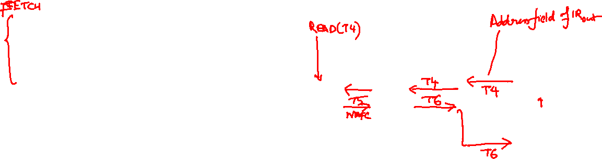
3. LOAD R1, LOCA (R1 = Mem[LOCA])
T1: PC_{out}, MAR_{in}, Read, Select4, Add, Z_{in}
T2: Z_{out}, PC_{in}, Y_{in}, MDR_{inE} ,WMFC
T3: MDR_{out}, IR_{in}
T4: Address field of IR_{out}, MAR_{in}, Read
T5: MDR_{inE} ,WMFC
T6: MDR_{out}, R1_{in}, End

Slide 48
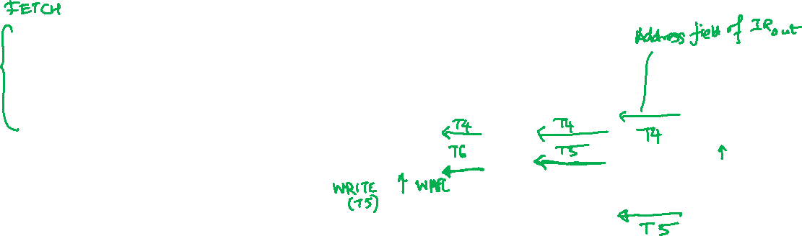
4. STORE LOCA, R1 (Mem[LOCA] = R1)
T1: PC_{out}, MAR_{in}, Read, Select4, Add, Z_{in}
T2: Z_{out}, PC_{in}, Y_{in}, MDR_{inE} ,WMFC
T3: MDR_{out}, IR_{in}
T4: Address field of IR_{out}, MAR_{in}
T5: R1_{out}, MDR_{in}, Write
T6: MDR_{outE}, WMFC, End

Slide 49
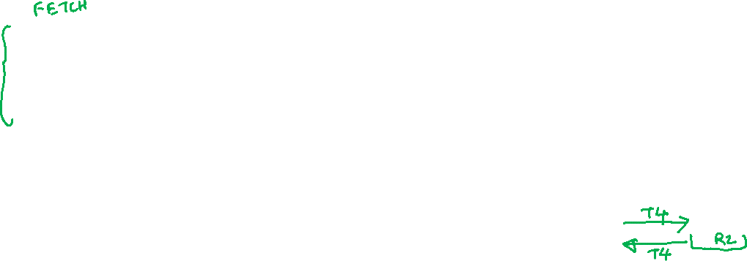
5. MOVE R1, R2 (R1 = R2)
T1: PC_{out}, MAR_{in}, Read, Select4, Add, Z_{in}
T2: Z_{out}, PC_{in}, Y_{in}, MDR_{inE} ,WMFC
T3: MDR_{out}, IR_{in}
T4: R2_{out}, R1_{in,} END

Slide 50
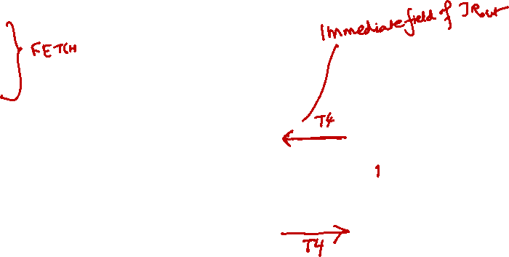
6. MOVE R1, #10 (R1 = 10)
T1: PC_{out}, MAR_{in}, Read, Select4, Add, Z_{in}
T2: Z_{out}, PC_{in}, Y_{in}, MDR_{inE} ,WMFC
T3: MDR_{out}, IR_{in}
T4: Immediate field of IR_{out}, R1_{in}, END

Slide 51
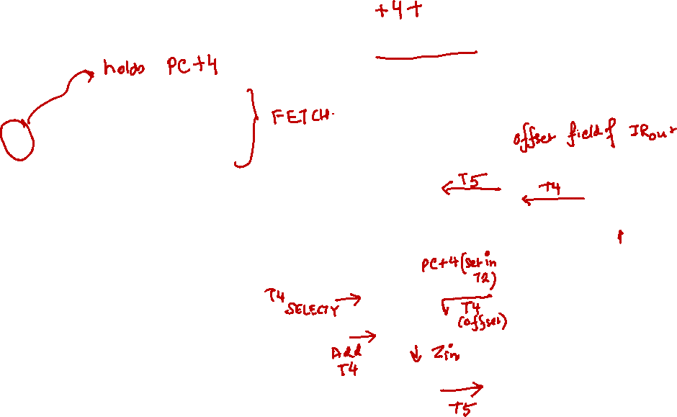
7. BRANCH Label (PC = PC + offset)
T1: PC_{out}, MAR_{in}, Read, Select4, Add, Z_{in}
T2: Z_{out}, PC_{in}, Y_{in}, MDR_{inE} ,WMFC
T3: MDR_{out}, IR_{in}
T4: Offset-field-of-IR_{out}, SelectY, Add, Z_{in}
T5: Z_{out}, PC_{in}, End

Slide 52
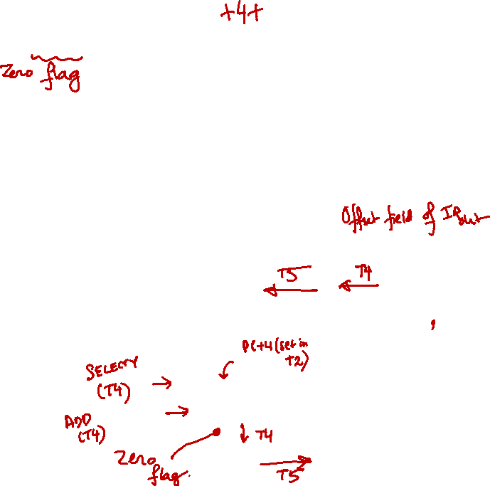
8. BZ Label (if Z=1, PC = PC + offset)
T1: PC_{out}, MAR_{in}, Read, Select4, Add, Z_{in}
T2: Z_{out}, PC_{in}, Y_{in}, MDR_{inE} ,WMFC
T3: MDR_{out}, IR_{in}
T4: Offset-field-of-IR_{out}, SelectY, Add, Z_{in}, If Z=0 then End
T5: Z_{out}, PC_{in}, End

Slide 53
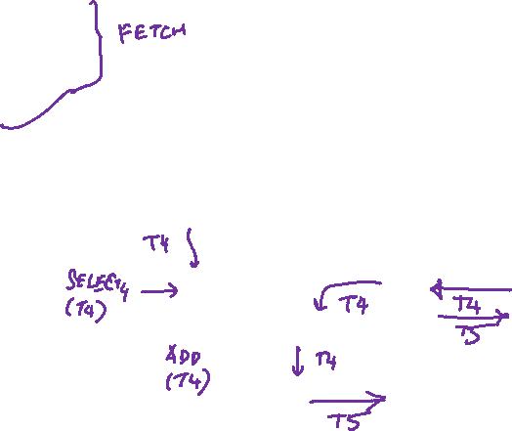
9. INC R1 (R1 = R1 + 4)
T1: PC_{out}, MAR_{in}, Read, Select4, Add, Z_{in}
T2: Z_{out}, PC_{in}, Y_{in}, MDR_{inE} ,WMFC
T3: MDR_{out}, IR_{in}
T4: R1_{out}, Select4, Add, Z_{in}
T5: Z_{out}, R1_{in}, End

Slide 54
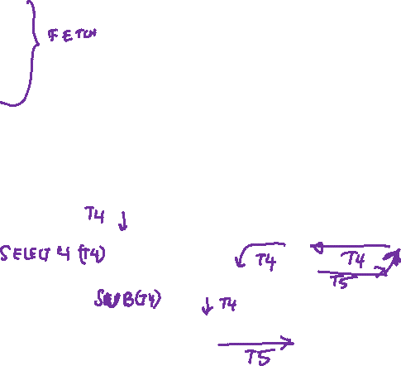
10. DEC R1 (R1 = R1 – 4)
T1: PC_{out}, MAR_{in}, Read, Select4, Add, Z_{in}
T2: Z_{out}, PC_{in}, Y_{in}, MDR_{inE} ,WMFC
T3: MDR_{out}, IR_{in}
T4: R1_{out}, Select4, Sub, Z_{in}
T5: Z_{out}, R1_{in}, End

Slide 55
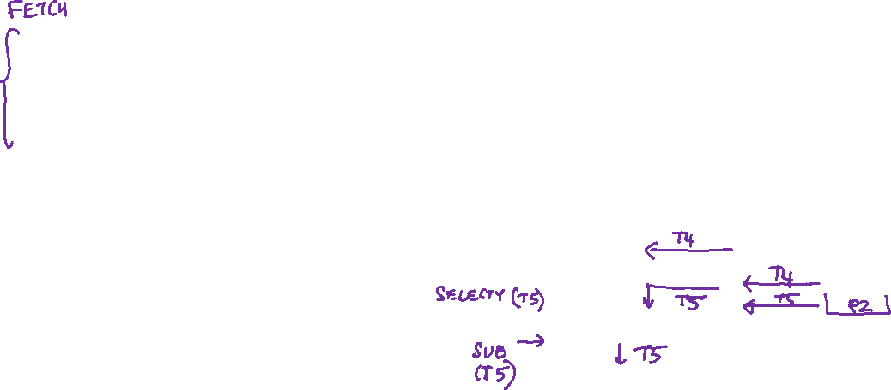
11. CMP R1, R2
T1: PC_{out}, MAR_{in}, Read, Select4, Add, Z_{in}
T2: Z_{out}, PC_{in}, Y_{in}, MDR_{inE} ,WMFC
T3: MDR_{out}, IR_{in}
T4: R1_{out}, Y_{in}
T5: R2_{out}, SelectY, Sub, Z_{in}, End

Slide 56
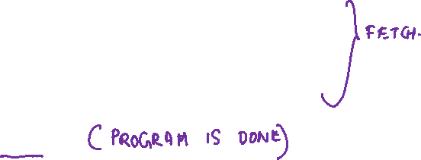
12. HALT
T1: PC_{out}, MAR_{in}, Read, Select4, Add, Z_{in}
T2: Z_{out}, PC_{in}, Y_{in}, MDR_{inE} ,WMFC
T3: MDR_{out}, IR_{in}
T4: END

Slide 57
ADD (R3), R1

Slide 58
Practice Assignment 1
Write down the micro-operations for the 12 instructions with respect to the 3-bus architecture.
Assumption: Two register read and one register write operations can be carried out concurrently in a single time step.

Slide 59
Practice Assignment 2
Complete the following table for both the 1-bus and 3-bus architectures.
  Ins-1 to Ins-12 indicates the instructions.
  The entries in the table will contain the corresponding micro-operations.
 | Ins-1 | Ins-2 | Ins-3 | Ins-4 | Ins-5 | Ins-6 | Ins-7 | Ins-8 | Ins-9 | Ins-10 | Ins-11 | nIs-12
T1
T2
T3
T4
T5
T6
T7

Slide 60
Hardwired and Microprogrammed Control Unit Design

Slide 61
Introduction
To execute an instruction, the processor must generate control signals for the data path in proper sequence.
  Example: ADD R1, R2
    R1_{out}, Y_{in}, SelectY
    R2_{out}, ADD, Z_{in}
    Z_{out}, R1_{in}
Two alternate approaches:
  Hardwired control unit design
  Microprogrammed control unit design

Slide 62
Hardwired Control Unit Design
What does the control unit do?
  It generates the control signals in proper sequence so as to execute any given instruction.
  We have already seen some example control signals for some instructions.
Basic question?
  For an instruction I_{k} and time step T_{m}, what are the control signals that need to be generated?
What is hardwired control unit?
  The control signals are generated by specific hardware circuits that cannot be easily modified.
  It is fixed or hardwired for a given <architecture, ISA> pair.

Slide 63
Overall Schematic Diagram
CLK
Control step
RESET
Clock
counter
..
Step decoder
T
T
..
T
1
2
n
INS₁
INS₂
:
External
Instruction Decoder
inputs
IR
:
Encoder
:
Condition
Codes flags
INS_{m}
..
Run
End
Control signals

Slide 64
Basic Principle of Operation:
  The step decoder provides separate signal for each step (T₁, T₂, T₃, etc.)..
  The instruction decoder has separate output lines for each machine instruction.
  For any instruction loaded in IR, one of the output line INS₁, …, INS_{m} is set to 1 (others are 0).
  The input signals to the encoder block are combined to generate individual control signals.
  The signal RUN causes the counter to be incremented by 1, stops counting when RUN = 0. This is needed when the WMFC signal is issued, causing the processor wait for a memory reply.
Assumption:
  Each time step is completed in one clock cycle.
  The control step counter keeps track of the time step.

Slide 65
The control signals are determined by the following information:
  Content of control step counter
  Content of instruction register
  Content of conditional code flags
  External input signals such as WMFC

Slide 66
The Encoder circuit is a combinational circuit which generates control signals depending on the inputs provided.
The Step Decoder generates separate signal lines for each step in the control sequence (T₁, T₂, T₃, etc.).
  Depending on maximum steps required for an instruction, the step decoder is designed.
  If a maximum of 10 steps are required, then a 4 x 16 step decoder is used.
Among the total set of instructions, the instruction decoder is used to select one of them. (That particular line will be 1 and rest will be 0).
  If a maximum of 100 instructions are present in the ISA, then a 7 x 128 instruction decoder is used.

Slide 67
At every clock cycle the RUN signal is used to increment the counter by one.
  When RUN is 0 the counter stops counting.
  This signal is needed when WMFC is issued.
The END signal starts a new instruction.
  It resets the control step counter to its starting value.
The sequence of operations carried out by the control unit is determined by the wiring of the logic elements and hence it is named hardwired.
  This approach of control unit design is fast but limited to the complexity of instruction set that is implemented.

Slide 68
Generation of Control Signals
(Hardwired Control)

Slide 69
ADD R1,R2
LOAD R1,LOCA
ADD R1,LOCA
BR Label
INC R1

Slide 70
ADD R1,R2
ADD R1,LOCA
LOAD R1,LOCA
BR Label
INC R1
 | I1 | I2 | I3 | I4 | I5
T1 | PC_{out}, MAR_{in}, Read, Select4, ADD, Z_{in} | PC_{out}, MAR_{in}, Read, Select4, ADD, Z_{in} | PC_{out}, MAR_{in}, Read, Select4, ADD, Z_{in} | PC_{out}, MAR_{in}, Read, Select4, ADD, Z_{in} | PC_{out}, MAR_{in}, Read, Select4, ADD, Z_{in}
T2 | Z_{out}, PC_{in}, Y_{in}, WMFC | Z_{out}, PC_{in}, Y_{in}, WMFC | Z_{out}, PC_{in}, Y_{in}, WMFC | Z_{out}, PC_{in}, Y_{in}, WMFC | Z_{out}, PC_{in}, Y_{in}, WMFC
T3 | MDR_{out}, IR_{in} | MDR_{out}, IR_{in} | MDR_{out}, IR_{in} | MDR_{out}, IR_{in} | MDR_{out}, IR_{in}
T4 | R1_{out}, Y_{in} | Address field of IR_{out}, MAR_{in}, Read | Address field of IR_{out}, MAR_{in}, Read | Offset field of IR_{out}, SelectY, ADD, Z_{in} | R1_{out}, Select4, ADD, Z_{in}
T5 | R2_{out}, SelectY, ADD, Z_{in} | R1_{out}, Y_{in}, WMFC | WMFC | Z_{out}, PC_{in}, END | Z_{out}, R1_{in}, END
T6 | Z_{out}, R1_{in}, END | MDR_{out}, SelectY, ADD, Z_{in} | MDR_{out}, R1_{in}, END
T7 |  | Z_{out}, R1_{in}, END

Slide 71
Logic for Generation of Some of the Control Signals
PC_{in} = T2 + T5.I4
PC_{out} = T1
MAR_{in} = T1 + T4.(I2 + I3)
Z_{in} = T1 + T4.(I4 + I5) + T6.I2
Z_{out} = T2 + T5.(I4 + I5) + T6.I1 + T7.I2
MDR_{out} = T3 + T6.(I2 + I3)
IR_{in} = T3
Y_{in} = T2 + T4.I1 + T5.I2
Select4 = T1 + T4.I5
SelectY = T4.I4 + T5.I1 + T6.I2
END = T5.(I4 + I5) + T6.(I1 + I3) + T7.I2
Rx_{in} = T5.I5 + T6.(I1 + I3) + T7.I2
Rx_{out} = T4.(I1 + I5) + T5.(I1 + I2)
WMFC = T2 + T5.(I2 + I3)

Slide 72
Design of the Encoder Block
Implement the logic functions to generate the control signals.
  Using logic gates or any other hardware module.
This method of generating control signals is very fast.

Slide 73
Practice Assignment 3
Design the hardwired control unit for the 12 instructions as given for:
  1-bus architecture
  3-bus architecture

Slide 74
Generation of Control Signals
(Microprogrammed Control)

Slide 75
Microprogrammed Control Unit Design
Control signals are generated by a program similar to machine language program.
A Control Store (CS) stores the microroutines for all instructions of an ISA.
The sequence of steps corresponding to the control sequence of a machine instruction is the microroutine.
Each sequence of steps is a Control Word (CW) whose individual bits represent the various control signals.
Individual control words in a microroutine are called microinstructions.

Slide 76
Starting and Branch Address Generator
External Inputs
IR
Condition Codes
Clock
μPC
Control Store
Control Word (CW)

Slide 77
Control-unit generates the control signals for an instruction by sequentially reading CWs of corresponding microroutine from CS.
The micro-program counter (μPC) is used to read CWs sequentially from CS.
Every time a new instruction is loaded into IR, output of Starting Address Generator is loaded into μPC.
Then, μPC is automatically incremented by clock causing successive microinstructions to be read from CS.
Starting and Branch Address Generator
External Inputs
IR
Condition Codes
Clock
μPC
Control Store
Control Word (CW)

Slide 78
Control Store Contents for “ADD R1, R2”
Micro- instr. | … | PC_{in} | PC_{out} | MAR_{in} | Read | MDR_{out} | IR_{in} | Y_{in} | Select | Add | Z_{in} | Z_{out} | R1_{out} | R1_{in} | R2_{out} | WMFC | End | …
1 | 0 | 0 | 1 | 1 | 1 | 0 | 0 | 0 | 1 | 1 | 1 | 0 | 0 | 0 | 0 | 0 | 0 | 0
2 | 0 | 1 | 0 | 0 | 0 | 0 | 0 | 1 | 0 | 0 | 0 | 1 | 0 | 0 | 0 | 1 | 0 | 0
3 | 0 | 0 | 0 | 0 | 0 | 1 | 1 | 0 | 0 | 0 | 0 | 0 | 0 | 0 | 0 | 0 | 0 | 0
4 | 0 | 0 | 0 | 0 | 0 | 0 | 0 | 1 | 0 | 0 | 0 | 0 | 1 | 0 | 0 | 0 | 0 | 0
5 | 0 | 0 | 0 | 0 | 0 | 0 | 0 | 0 | 0 | 1 | 1 | 0 | 0 | 0 | 1 | 0 | 0 | 0
6 | 0 | 0 | 0 | 0 | 0 | 0 | 0 | 0 | 0 | 0 | 0 | 1 | 0 | 1 | 0 | 0 | 1 | 0

Slide 79
Control Store Contents for “BR Label”
Micro- instr. | … | PC_{in} | PC_{out} | MAR_{in} | Read | MDR_{out} | IR_{in} | Y_{in} | Select | Add | Z_{in} | Z_{out} | IR_{out} | WMFC | End | …
1 | 0 | 0 | 1 | 1 | 1 | 0 | 0 | 0 | 1 | 1 | 1 | 0 | 0 | 0 | 0 | 0
2 | 0 | 1 | 0 | 0 | 0 | 0 | 0 | 1 | 0 | 0 | 0 | 1 | 0 | 1 | 0 | 0
3 | 0 | 0 | 0 | 0 | 0 | 1 | 1 | 0 | 0 | 0 | 0 | 0 | 0 | 0 | 0 | 0
4 | 0 | 0 | 0 | 0 | 0 | 0 | 0 | 0 | 0 | 1 | 1 | 0 | 1 | 0 | 0 | 0
5 | 0 | 1 | 0 | 0 | 0 | 0 | 0 | 0 | 0 | 0 | 0 | 1 | 0 | 0 | 1 | 0

Slide 80
Using Conditional Branching
The previous organization cannot handle the situation when the control unit is required to check the status of the condition codes or external inputs to choose between alternative courses of action.
Possible solution:
  Use conditional branch microinstruction.
  An example is shown on the next slide.

Slide 81
Address
Microinstruction
0
PC
,
MAR
,
Read,
Select4,
Add,
Z
out
in
in
1
Z
,
PC
,
Y
,
WMFC
out
in
in
2
MDR
,
IR
out
in
3
Branch
to
starting
address
of
appropriate
microroutine
.
.
.
.
.
.
.
.
.
.
.
.
.
.
.
.
.
.
.
.
.
.
.
.
.
.
.
.
.
.
.
.
.
.
.
.
.
.
.
.
.
.
.
.
.
.
.
.
.
.
.
.
.
.
.
.
.
.
.
.
.
.
.
.
.
.
25
If
Z=0,
then
branch
to
microinstruction 0
26
Offset-field-of-IR
,
SelectY,
Add,
Z
out
in
27
Z
,
PC
in
,
End
out

Slide 82
Starting and Branch Address Generator
External Inputs
IR
Condition Codes
Clock
μPC
Control Store
Control Word (CW)

Slide 83
Microprogram Sequencing
If all microprograms require only straightforward sequential execution of microinstructions except for branches, letting a μPC govern the sequencing would be efficient.
However, two disadvantages:
  Having a separate microroutine for each machine instruction results in a large total number of microinstructions and a large control store.
  Longer execution time because it takes more time to carry out the required branches.

Slide 84
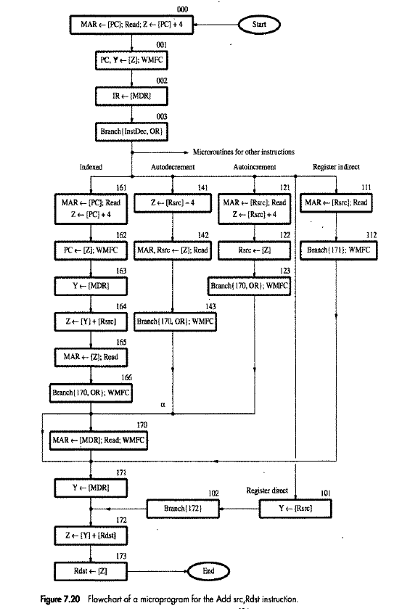

Slide 85
Microinstructions with Next-Address Field
The microprogram requires several branch microinstructions, which perform no useful operation in the datapath.
An alternative approach:
  Include an address field as a part of every microinstruction to indicate the location of the next microinstruction to be fetched.
Pros: separate branch microinstructions are virtually eliminated; few limitations in assigning addresses to microinstructions.
Cons: additional bits required for the address field.

Slide 86
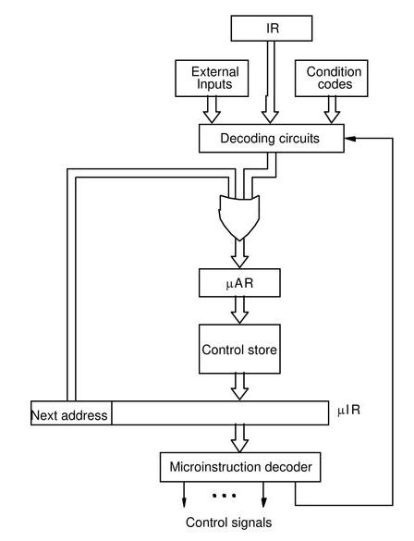
From the instruction opcode, some constant bits are appended (both at the left and right) to get the starting address of the corresponding micro-routine in control store.
μPC

Slide 87
Illustrative Example
Some example instructions and their 4-bit opcodes:
Opcodes Starting Address of Micro-routine
  ADD 0010 0 0010 000
  SUB 0011 0 0011 000
  LOAD 0100 0 0100 000
  STORE 0101 0 0101 000
  BR 1010 0 1010 000

Slide 88
Practice Assignment 4
Design the microprogrammed control unit for the 12 instructions as given for the 1-bus architecture.
In particular, show the micro-routines for the various instructions, and the detailed contents of CS.

Slide 89
Horizontal versus Vertical Microinstruction Encoding
Broadly there are two alternate schemes to code the control signals in the control memory.
  Horizontal Micro-instruction Encoding
    Each control signal is represented by a bit in the micro-instruction.
    Fewer control store words, with more bits per word.
  Vertical Micro-instruction Encoding
    Each control word represents a single micro-instruction in encoded form.
    k-bit control word can support up to 2^{k} micro-instructions.
    More control store words, with fewer bits per word.

Slide 90
There can be a tradeoff between horizontal and vertical micro-instruction encoding.
  Sometimes referred to as Diagonal Micro-instruction Encoding.
  The control signals are grouped into sets S₁, S₂, etc., such that the control signals within a set are mutually exclusive.
Summary:
  Horizontal encoding supports unlimited parallelism among micro-instructions.
  Vertical encoding supports strictly sequential execution of micro-instructions.
  Diagonal encoding does not sacrifice the required level of parallelism, but uses less number of bits per control word as compared to horizontal encoding.

Slide 91
(a) Horizontal Micro-instruction Encoding
…
c₁
c₂
c₃
c₄
c_{k}
Control Signals
Suppose that there are k control signals: c₁, c₂, …, c_{k}.
In horizontal encoding, every control word stored in control memory (CM) consists of k bits, one bit for every control signal.
Several bits in a control word can be 1:
  Parallel activation of several micro-operations in a single time step.
0
1
0
1
1
0
→ c₂, c₄ and c₅ are activated together

Slide 92
Advantage:
  Unlimited parallelism is possible in the activation of the micro-operations.
Disadvantage:
  Size of the control memory is large (word size is much longer).
  Cost of implementation is higher.

Slide 93
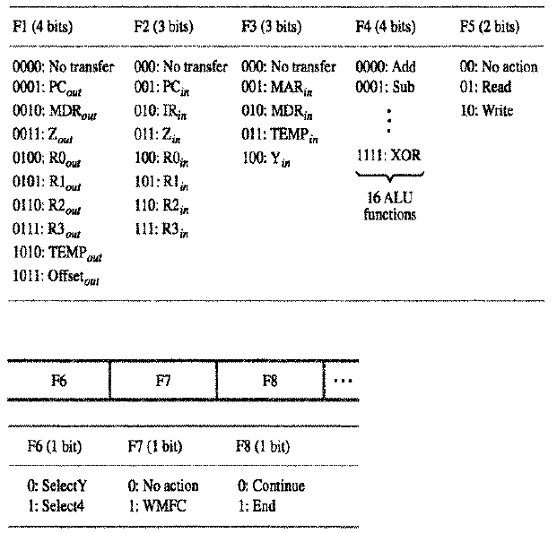
Example
fefew

Slide 94
(b) Vertical Micro-instruction Encoding
Again consider that there are k control signals: c₁, c₂, …, c_{k}.
We encode the control signals in an m-bit word in the control memory, where k ≤ 2^{m}.
Depending on the m-bit control word, exactly one control signal will be activated (= 1), while all others will remain de-activated (= 0).
  At most one control signal can be activated in a time step.
m-bit word
DECODER
…
c₁
c₂
c₃
c₄
c_{k}

Slide 95
Advantage:
  Requires much smaller word size in control memory.
  Low cost of implementation.
Disadvantage:
  More than one control signals cannot be activated at a time.
  Requires sequential activation of the control signals, and hence more number of time steps.

Slide 96
(c) Diagonal Micro-instruction Encoding
…
m₁-bit
m₂-bit
m₃-bit
m_{s}-bit
DECODER
DECODER
DECODER
…
…
…
c_{1,1}
c_{1,k1}
c_{2,1}
c_{2,k2}
c_{m,1}
c_{m,ks}
Suppose we group the set of k control signals into s groups, containing k₁, k₂, …, k_{s} signals.
We encode the control signals in groups as shown, where k_{i} ≤ 2^{mi}.
  Within a group, at most one control signal can be activated in a time step.
  Parallelism across groups is allowed.

Slide 97
Advantages:
  Maximum parallelism as required by the micro-programs can be supported.
  Word size of control memory is less than that for horizontal encoding.
  Used in practice.
Disadvantages:
  Multiple decoders (though smaller in sizes) are required.

Slide 98
Example 1
Suppose there are 100 control signals in a processor data path.
  For horizontal encoding, control word size = 100 bits.
  For vertical encoding, control word size = log₂ 100 = 7 bits.
  For diagonal encoding, suppose after analysis of the micro-programs, we divide the control signals into 5 groups, containing 25, 15, 40, 5 and 15 control signals respectively.
    We have: m₁ = 5, m₂ = 4, m₃ = 6, m₄ = 3, m₅ = 4
    Control word size = 5 + 4 + 6 + 3 + 4 = 22 bits.
25 ≤ 2⁵ 15 ≤ 2⁴
40 ≤ 2⁶ 5 ≤ 2³
15 ≤ 2⁴

Slide 99
A Single Cycle Data Path

Slide 100
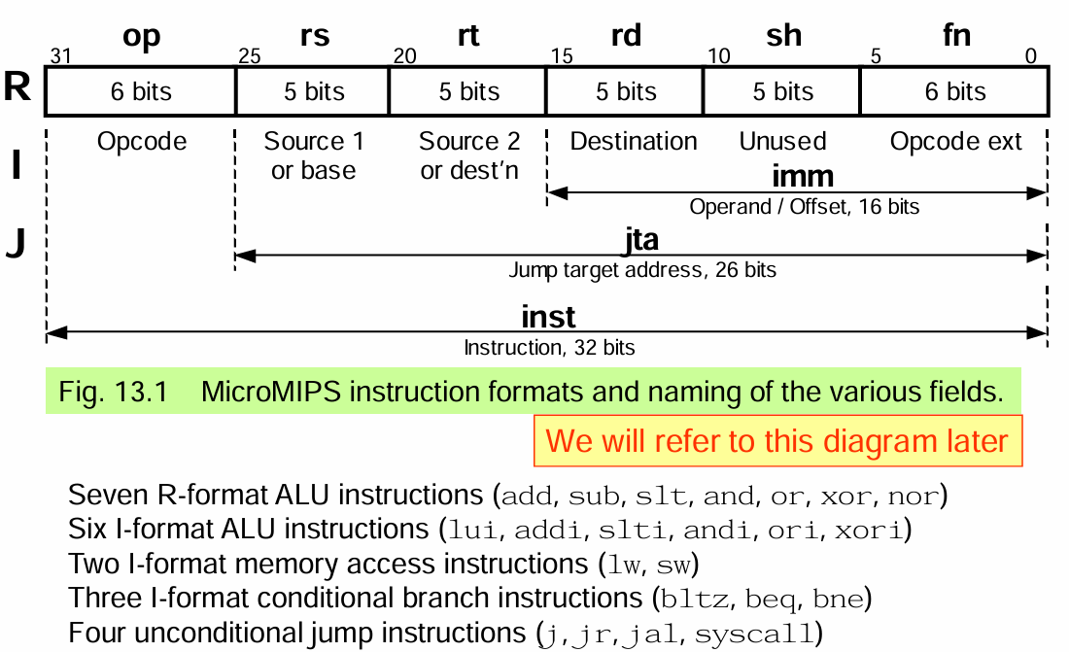
A small set of instructions

Slide 101
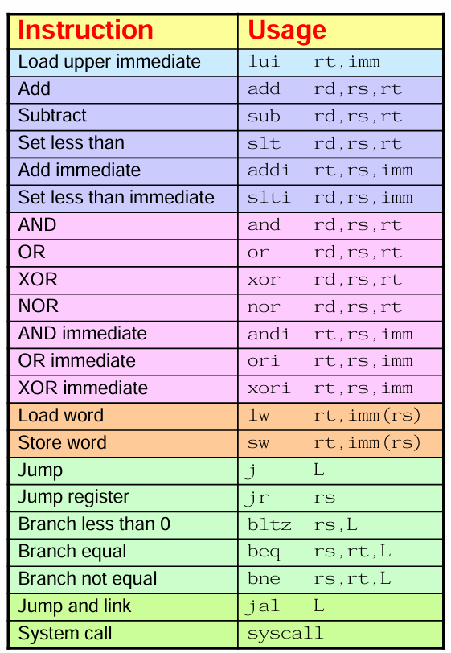
The instruction Set
Copy
Arithmetic
Logic
Memory Access
Control Transfer

Slide 102
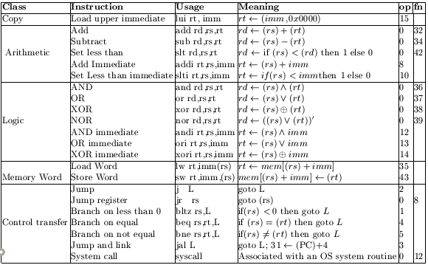
The Micro Mips ISA

Slide 103
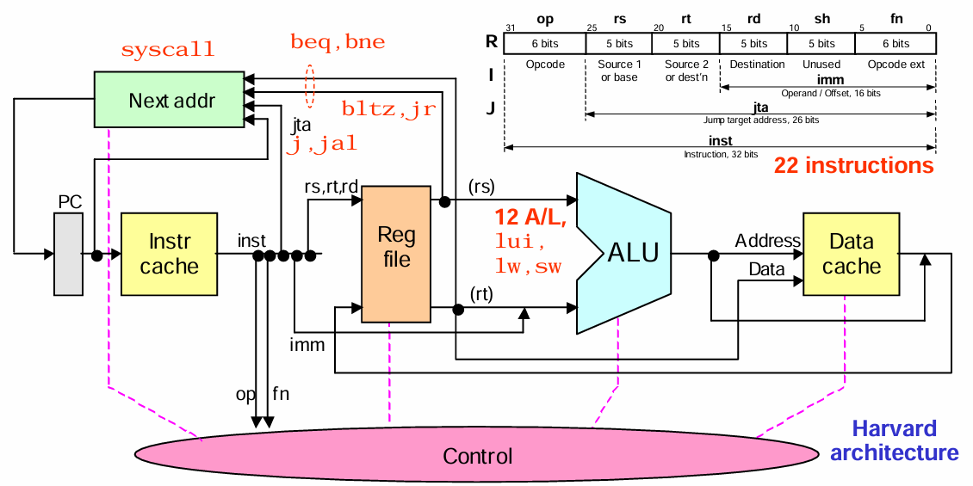
Instruction Execution Unit

Slide 104
The Instruction Format
op
rs
rt
rd
sh
fn
6 bits
5 bits
5 bits
5 bits
5 bits
6 bits
Opcode
Source 1
or base
Source 2
or dest
Destination
Unused
Opcode ext
imm
Operand.offset,16 bits
jta
jump target address

Slide 105
Abstraction of Instruction Execution Unit
NEXT
ADDRESS
jta
PC
rs,rt,rd
REG
FILE
INSTR
CACHE
ALU
(rs)
Addr
DATA
CACHE
(rt)
Data
op
fn
imm
CONTROL UNIT

Slide 106
Register File
2^{h} k-bit registers
Write Data
FF
Write Address
Read
data 0
FF
Decoder
Read
data 1
MUXES
Write
Enable
FF
FF
Read Address 0
Read Address 1
Read
Enable

Slide 107
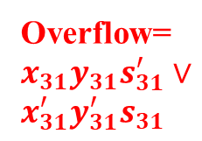
The ALU Architecture
fn:
00: lui
01 Set less
10 Arithmetic
11 Logic
Pad 16 0s
FnClass
cin
x
ALU
MSB: 0 or 1
y
y or y’
XOR
c31
c32
Add’
/Sub
LOGIC
AND 00
OR 01
XOR 10
NOR 11
Overflow=$x_{31}y_{31}s_{31}^{′}∨x_{31}^{′}y_{31}^{′}s_{31}$
XOR
LogicFn

Slide 108
Execution Steps for R-type ALU Instructions
Read contents from rs and rt, and pass them to the ALU.
Control the ALU to perform the correct operation, according to the “func”-value of the Instruction.
Write the output of the ALU in register rd.

Slide 109
Execution Steps for I-type ALU Instructions
Contents of rs and immediate value in the instruction are forwarded as inputs to the ALU.
Control the ALU to perform appropriate function.
Result is stored in the register rt (rather than rd in case of R-type instructions).

Slide 110
Execution Steps for I-type Memory Instructions
Read contents of rs.
Add the contents of rs to signed extended immediate value in the instruction to form a memory address.
Read from or write to the memory location computed thus.
In case of lw, place the result in rt.
In case of sw, copy the result from rt.

Slide 111
Register Access and ALU
PC
rs
(rs)
REG
FILE
ALU
INSTR
CACHE
(rs)
rt
rt
(rt)
rd
31
(rt)
imm
RegDst
RegWrite
ALUimm
ALUFunc

Slide 112
Writing of the ALU output
rs
(rs)
REG
FILE
ALU
Data
Addr
DATA
CACHE
(rs)
rt
rt
(rt)
rd
31
(rt)
Data
In
SE
32
16
imm
IncrPC
RegDst
RegWrite
ALUimm
ALUFunc
Data
Read
Data
Write
RegInData

Slide 113
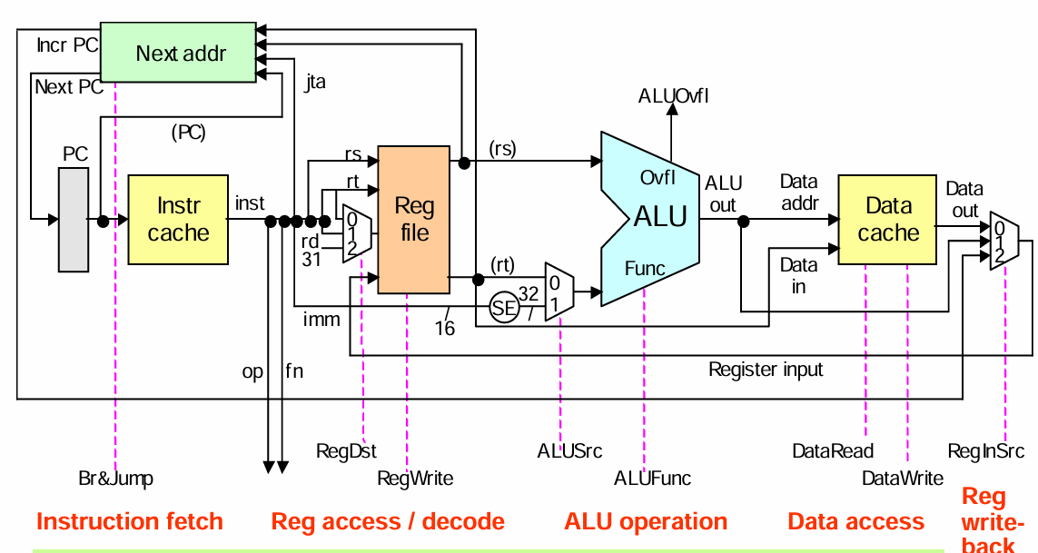
A single cycle data path

Slide 114
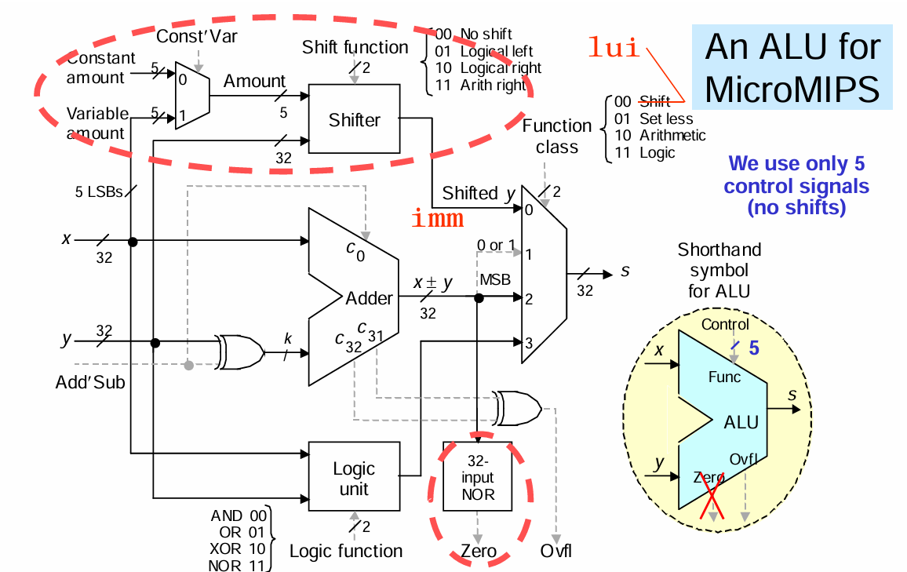

Slide 115
The Next Address Architecture
BrTrue
Branch
Condition
Checker
(rt)
IncrPC
Adder
(rs)
SE
(PC)_{31:2}
4 MSBs
of PC
16 bits
1
30 bits
26 bits
jta
Next PC
SysCallAddr
PCSrc
BrType

Slide 116
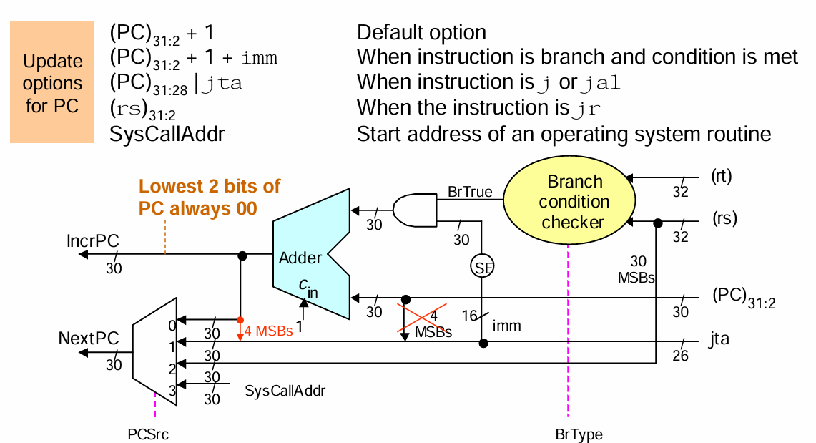
Slightly Modified Branching and jumping (Next Address Logic)

Slide 117
Pseudo-Direct Addressing
Consider a program:
0x1000_0000 LD R1, 0(R2)
0x1000_0100 J Label //Instruction: 0x08000440
0x1000_1000 …
Label: 0x1000_1100 …
Why does this work?

Slide 118
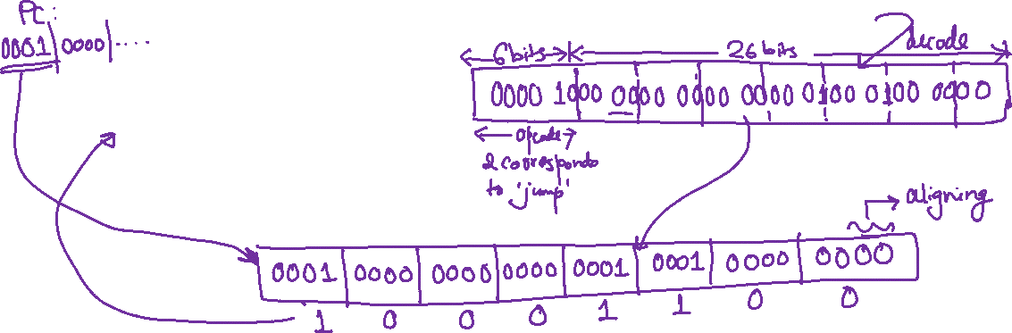
Pseudo-Direct Addressing
Consider a program:
0x1000_0000 LD R1, 0(R2)
0x1000_0100 J Label //Instruction: 0x08000440
0x1000_1000 …
Label: 0x1000_1100 …
Why does this work?

Slide 119
Lets move the code to a different memory location
Consider a program:
0x2000_0000 LD R1, 0(R2)
0x2000_0100 J Label //Instruction: 0x08000440
0x2000_1000 …
Label: 0x2000_1100 …
Does this work?

Slide 120
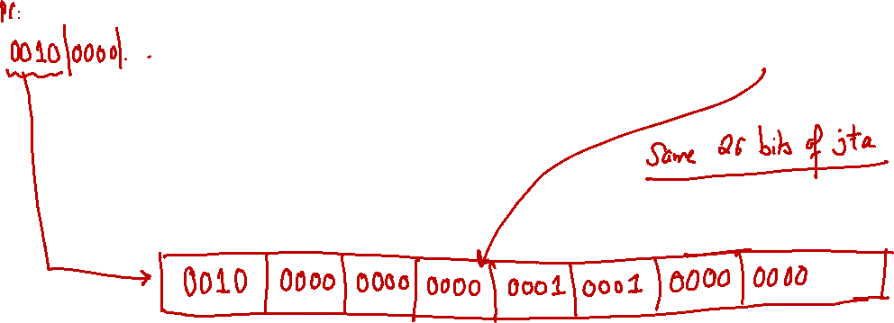
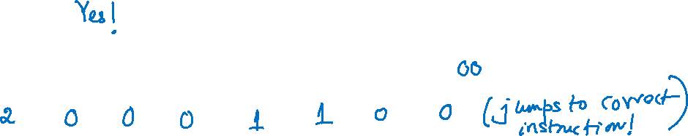
Lets move the code to a different memory location
Consider a program:
0x2000_0000 LD R1, 0(R2)
0x2000_0100 J Label //Instruction: 0x08000440
0x2000_1000 …
Label: 0x2000_1100 …
Does this work?

Slide 121

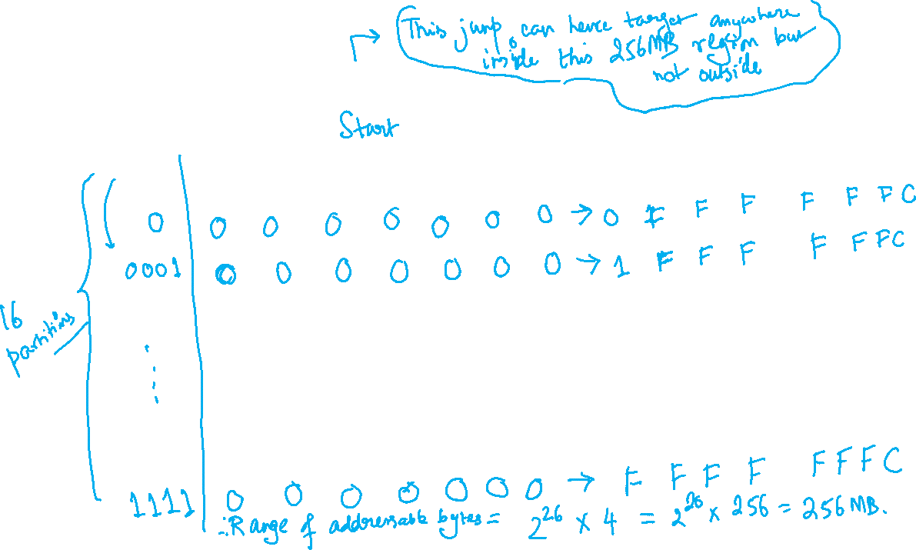


Partitions a 4GB address space…

Slide 122

Pseudo-Direct Addressing
A pseudo-direct jump can reach up to $2^{26}=67,108,864226=67,108,864$ instructions inside the current 256 MB region.
That is about 67 million instructions maximum per region.

Slide 123
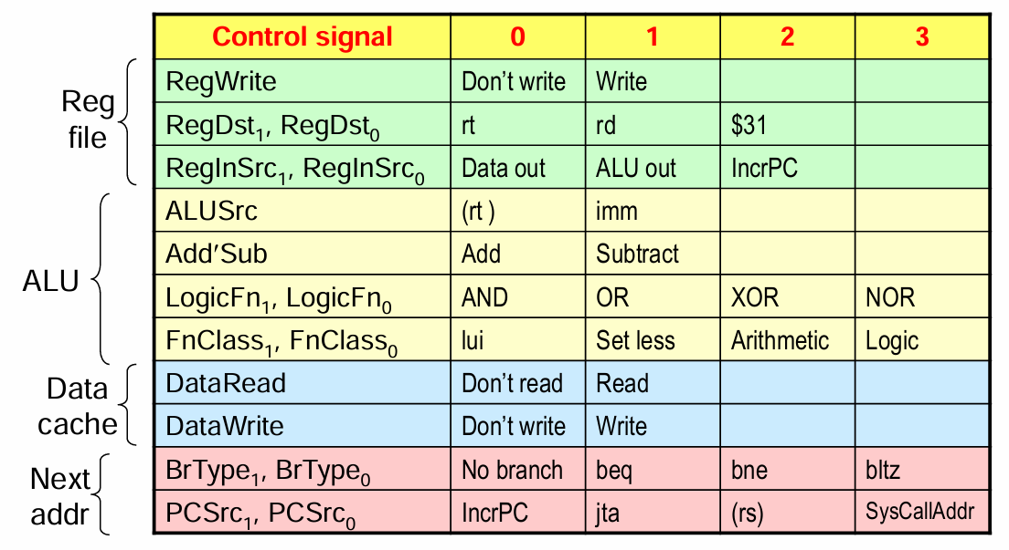
Deriving the Control Signals

Slide 124
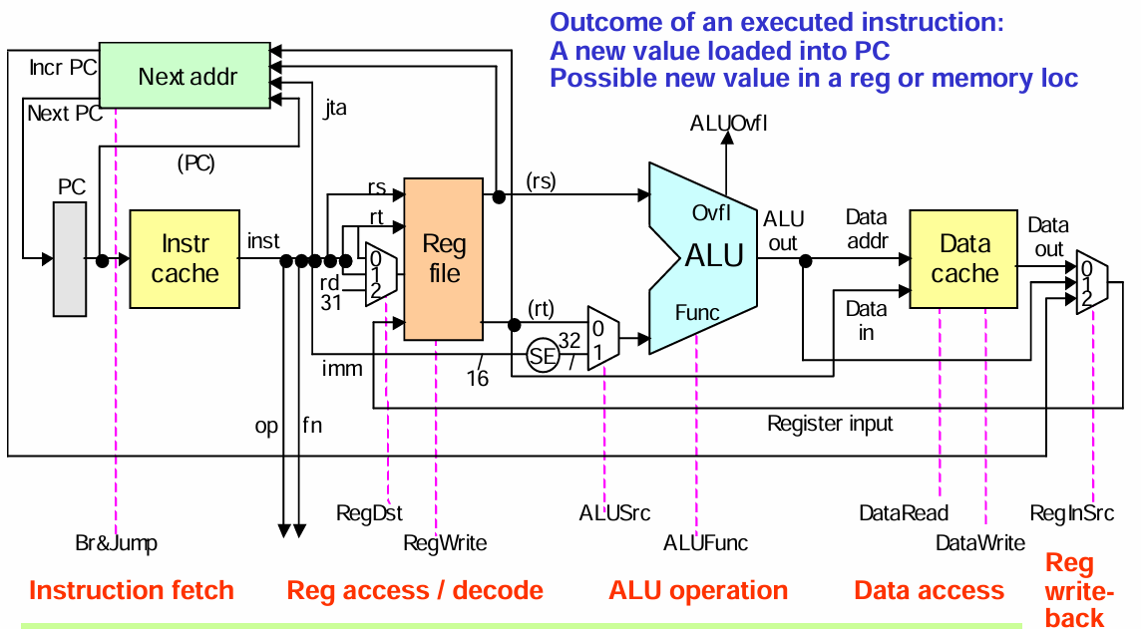
Single Cycle Data Path

Slide 125
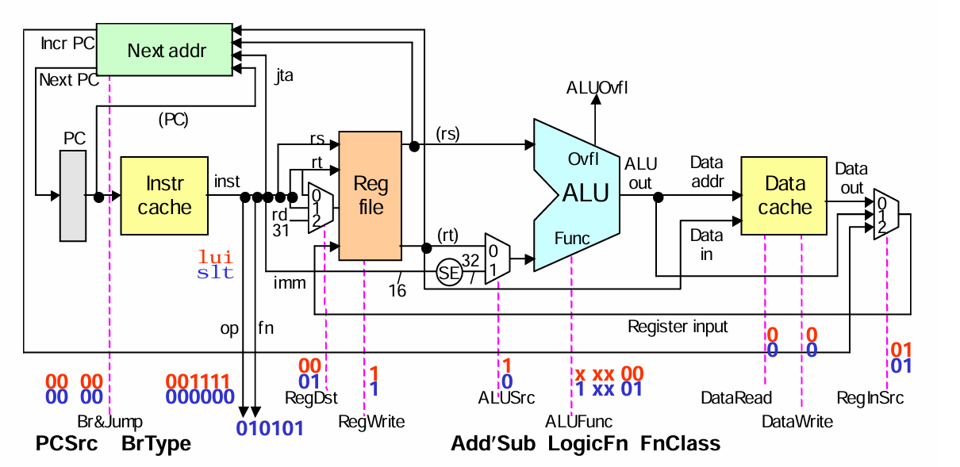
Control Signals in Single Cycle Data Path
101010

Slide 126
Control Signal Settings: Repeated for Reference

Slide 127
Generating Control Signals
The control signals are a function of op and fn fields.
One can express the control signals as a function of the op and fn bits.
  It is quite easy
However, the demerit of such an approach is if the instruction set is modified, or if we add new instructions, the entire control unit needs to be redesigned.

Slide 128
The Decoder based control unit
6
RtypeInst
6
0
op
fn
1
bltzInst
2
8
jrInst
jInst
3
jalInst
12
syscallInst
4
beqInst
5
bneInst
1
8
addiInst
32
addInst
10
sltiInst
34
subInst
12
andiInst
36
andInst
13
oriInst
37
orInst
14
xoriInst
38
xorInst
15
luiiInst
39
norInst
35
lwInst
42
sltInst
43
swInst

Slide 129
Expressing the Control Signals
Auxiliary signals:
  arithInst=addInst V subInst V sltInst V addiInst V sltiInst
  logicInst=andInst V orInst V xorInst V norInst V andiInst V oriInst V xoriInst
  immInst = luiInst V addiInst V sltiInst V andiInst V oriInst V xoriInst
Some Control Signals:
  RegWrite=luiInst V arithInst V logicInst V lwInst V jalInst
  ALUSrc=ImmInst V lwInst V swInst

Slide 130
Performance of the Single Cycle Architecture
The above design of control circuit is a stateless and combinational design.
Each new instruction is read from the PC, and is executed in one single clock.
  Thus CPI=1
The clock cycle is determined by the longest instruction.

Slide 131
Performance Estimation for Single-Cycle MicroMIPS
Instruction access 2 ns
Register read 1 ns
ALU operation 2 ns
Data cache access 2 ns
Register write 1 ns
Total 8 ns
Single-cycle clock = 125 MHz
R-type 44% 6 ns
Load 24% 8 ns
Store 12% 7 ns
Branch 18% 5 ns
Jump 2% 3 ns
Weighted mean ≅ 6.36 ns
The MicroMIPS data path unfolded (by depicting the register write step as a separate block) so as to better visualize the critical-path latencies.

Slide 132
lw is the longest instruction
lw execution includes all the possible steps:
  Instruction Access: 2 ns
  Register Read: 1 ns
  ALU operation: 2 ns
  Data Cache Access: 2 ns
  Register Write-back:1 ns
  Total: 8 ns
  Thus a clock frequency of 125 MHz suffices.
  So, for 1 instruction, (1/125) x 10⁻⁶ sec
  Thus, 125 Million Instructions are executed per second (125 MIPS)

Slide 133
Obtaining better performance
Note that the average instruction time is less, depends on the type of instruction, and their percentages in an application.
Rtype 44% 6 ns No data cache
Load 24% 8 ns
Store 12% 7ns No register write-back
Branch 18% 5ns Fetch+Register Read+Next-addr formation
Jump 2% 3ns Fetch + Instruction Decode
Weighted average = 6.36 ns
So, with a variable cycle time implementation, the performance is 157 MIPS
However, this is not possible.
We see that a single cycle implementation has a poor performance.

Slide 134
Summary
Clock cycle is determined by the slowest instruction.
If the MIPS ISA includes more complex instructions, the disadvantage is more.
  For example if we add a MULT/DIV instruction by k times, then all operations need to be slowed down by k times.
  Thus MIPS does the MIPS/DIV instruction to a separate block (than the ALU block), with separate registers Hi and Lo.
    sufficient time is kept to write back the results to the register file

